Slide 1
K-Nearest Neighbour

Slide 2
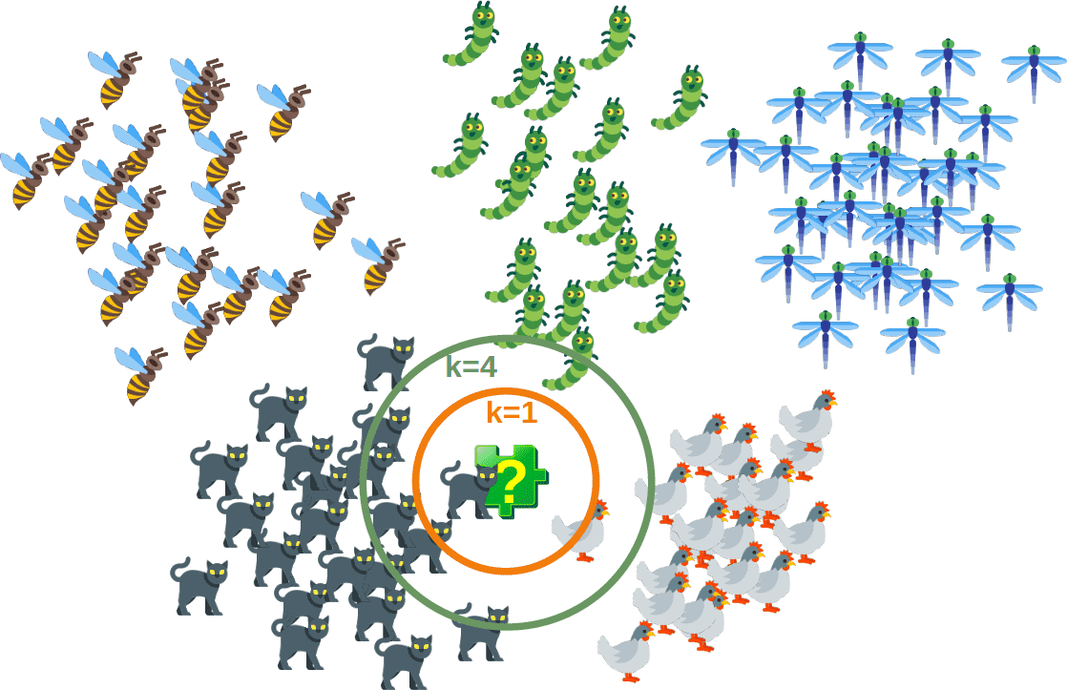
KNN tries to predict the correct class for the test data by calculating the distance between the test data and all the training points. K number of points which is closet to the test data. The KNN algorithm calculates the probability of the test data belonging to the classes of ‘K’ training data and class holds the highest probability will be selected.

Slide 3
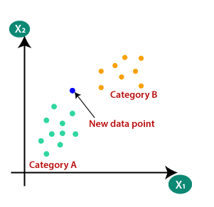
Working of K-NN algorithm
Consider example that two categories, i.e., Category A and Category B, and we have a new data point x1, so this data point will lie in which of these categories. To solve this type of problem, we need a K-NN algorithm.

Slide 4
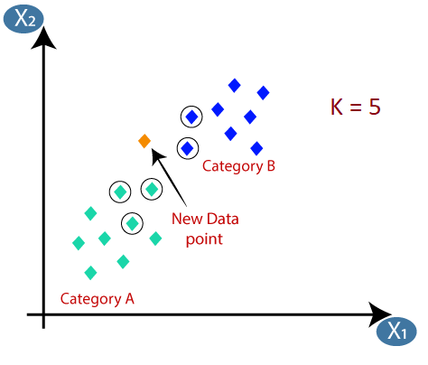
Step-1: Select the number K of the neighbors (i.e K = 5)
Step-2: Calculate the Euclidean distance of K number of neighbors.
Step-3: Take the K nearest neighbors as per the calculated Euclidean distance.

Slide 5
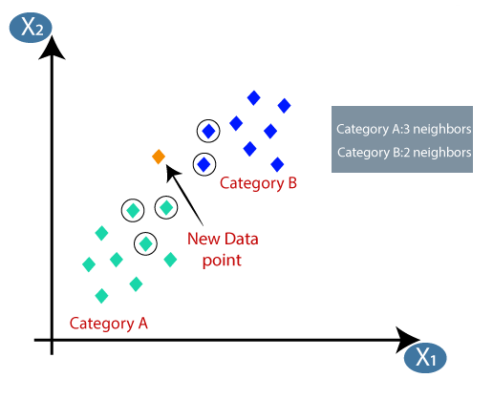
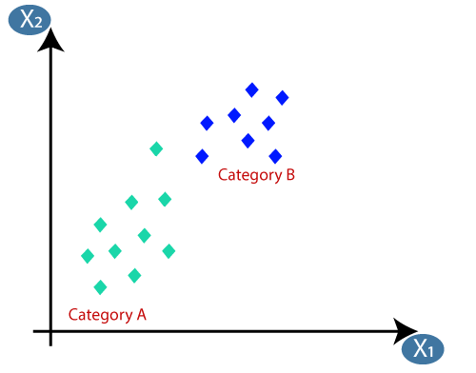
Step-4: Among these k neighbors, count the number of the data points in each category.
Step-5: Assign the new data points to that category for which the number of the neighbor is maximum.
Step-6: Our model is ready.

Slide 6
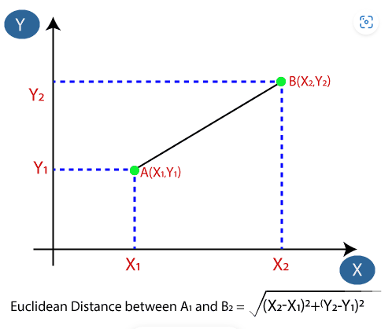
Euclidean distance between the data points is the distance between two points. It can be calculated as:
Note:- Metric to use for distance computation is “minkowski”, which results in the standard Euclidean distance when p = 2.

